Slide 1
EDGE extraction ACCELERATION ON fpga
Ruihao Li
Guihong Li
Department of Electrical and Computer Engineering
The University of Texas at Austin

Slide 2
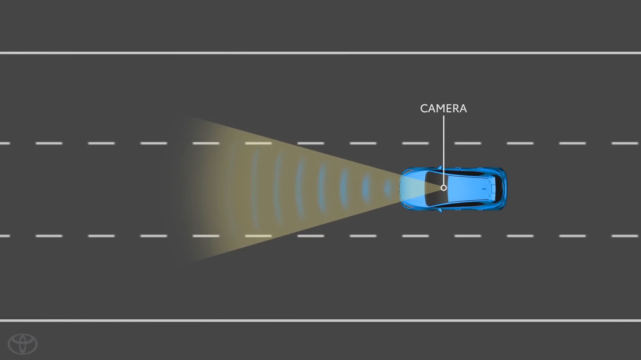

Slide 3
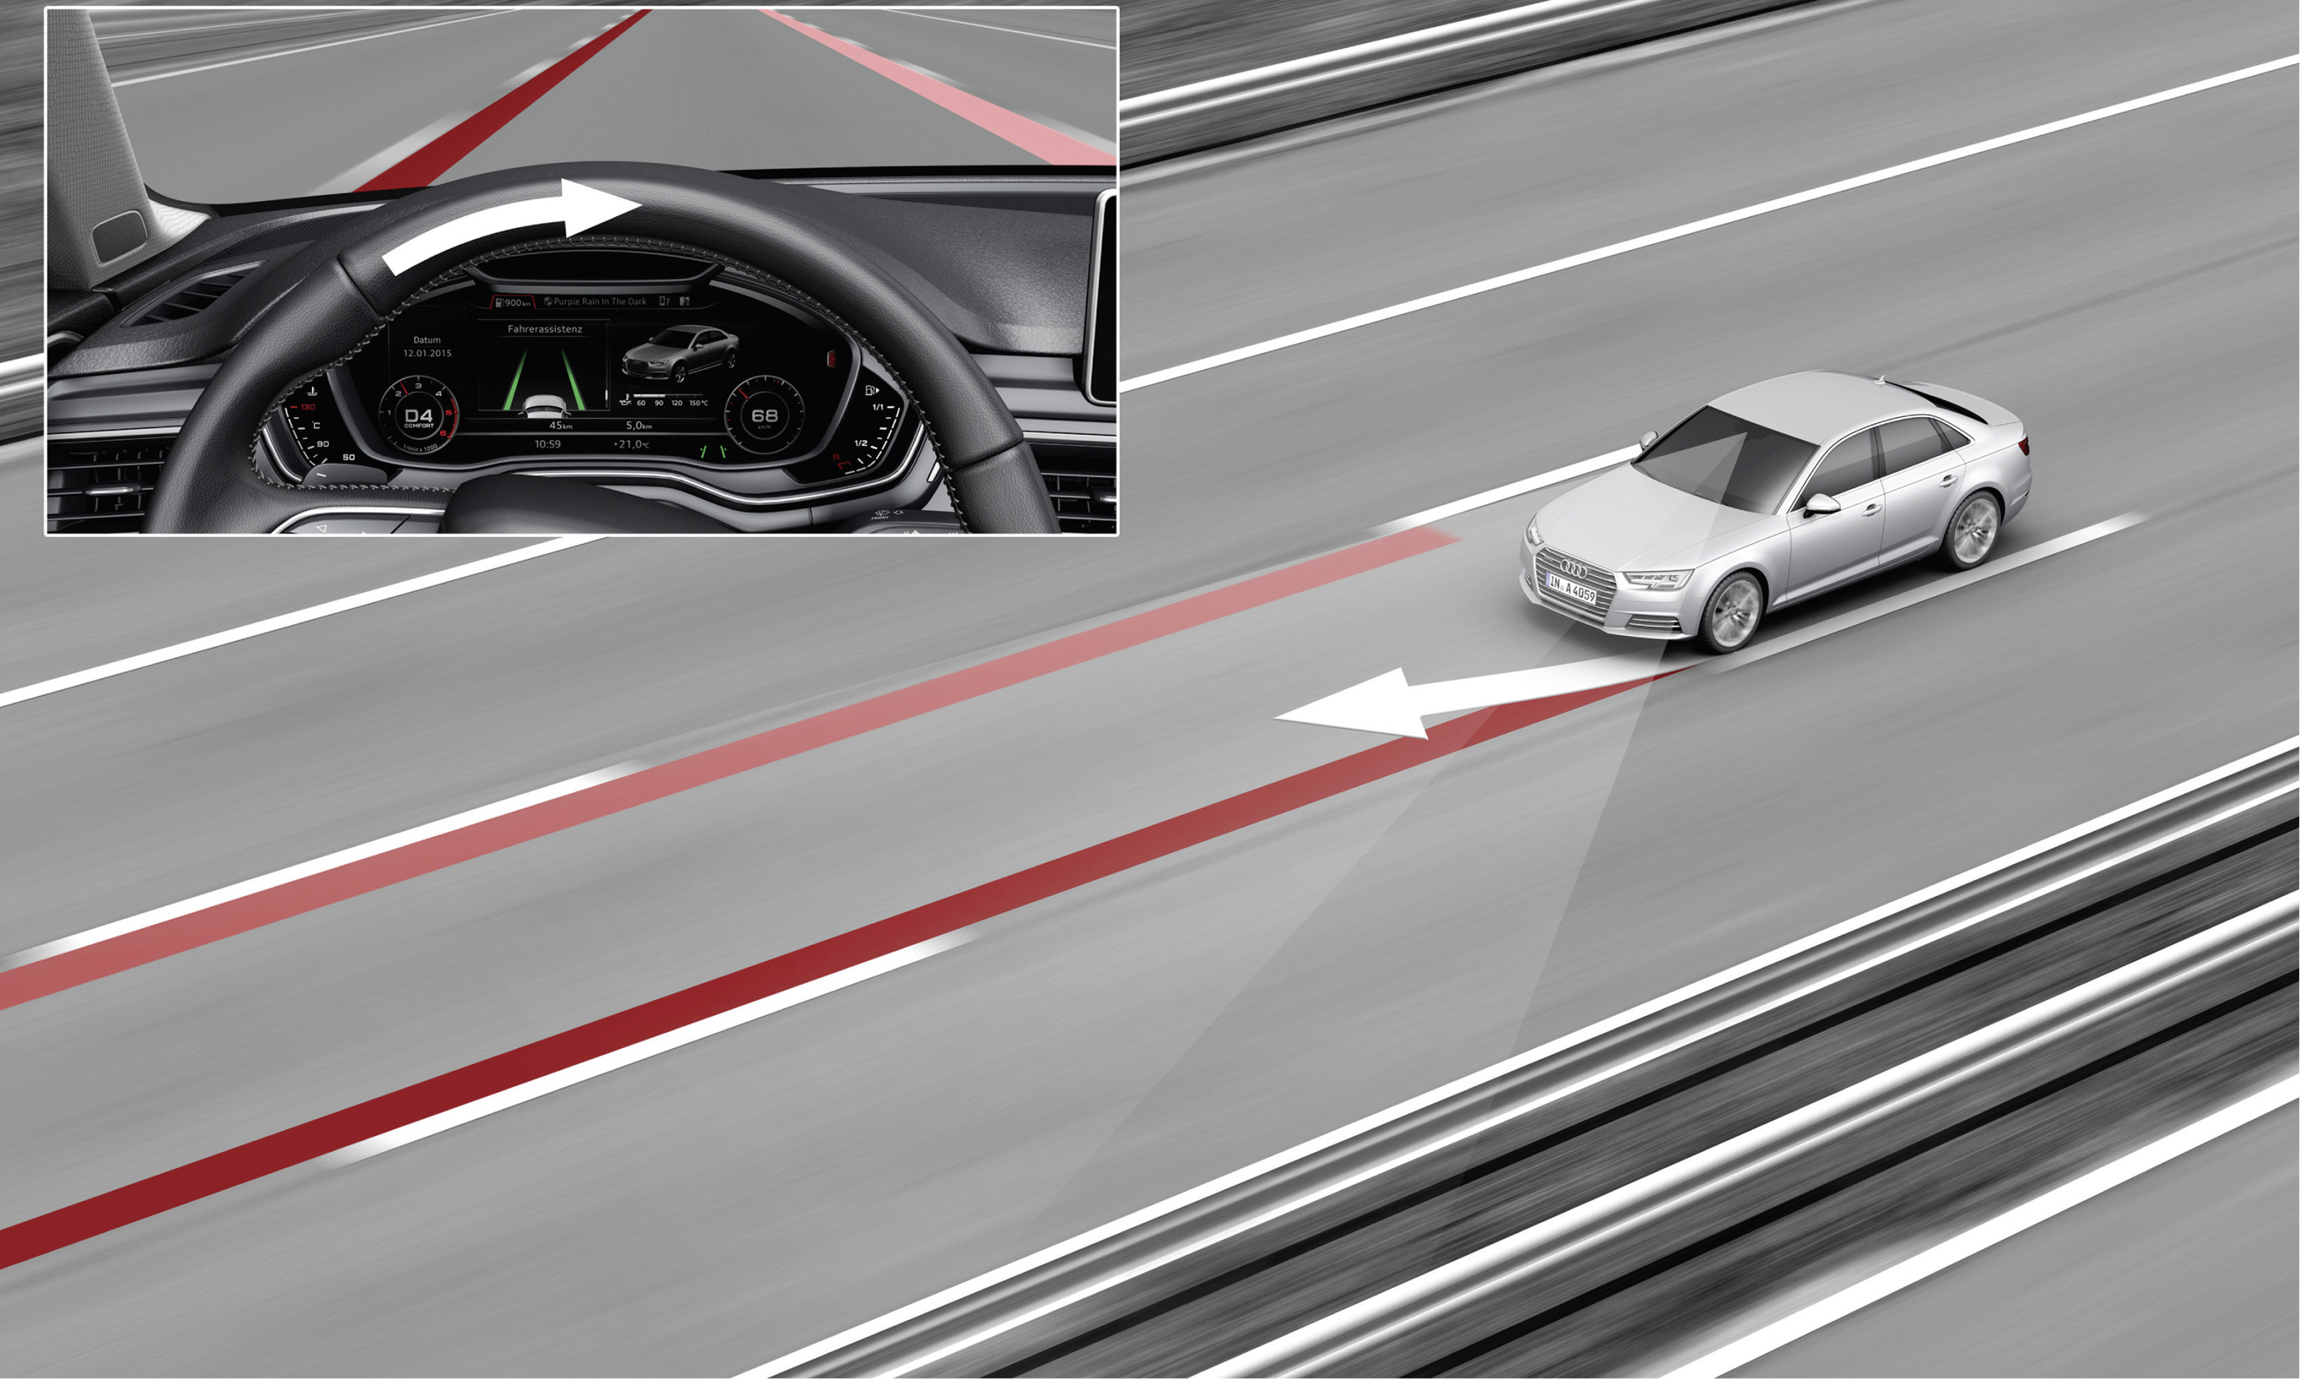
How does your car trace the lane automatically?

Slide 4
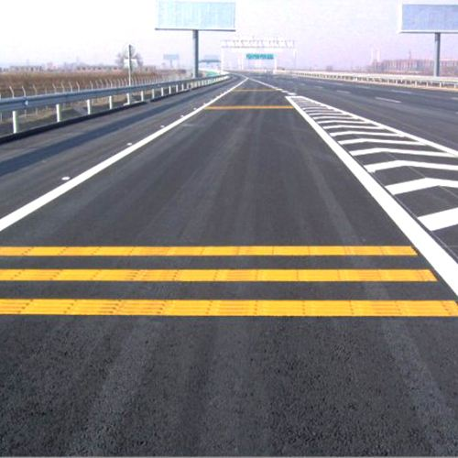
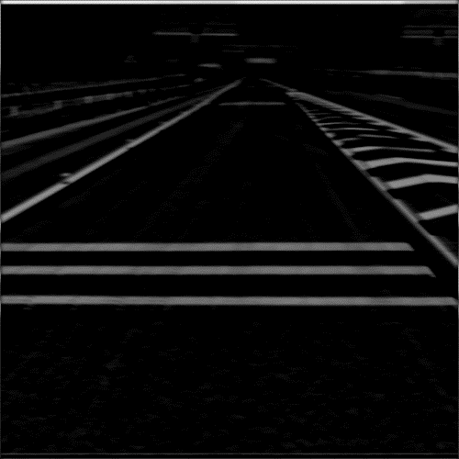
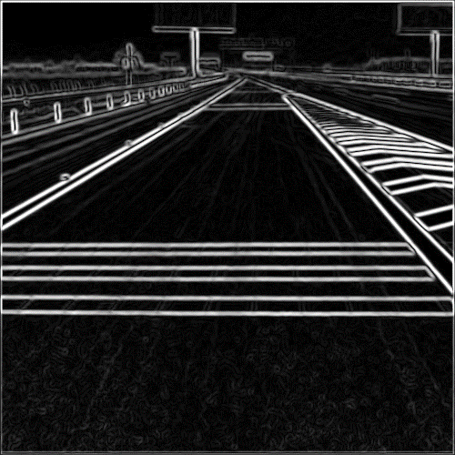
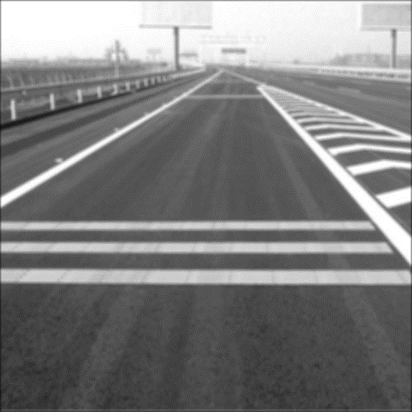

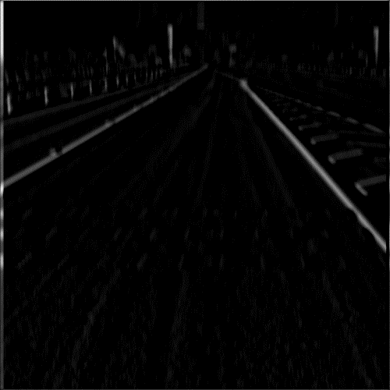

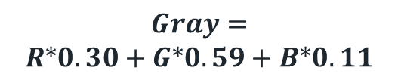
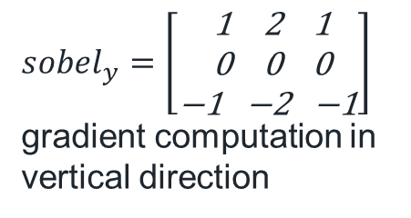
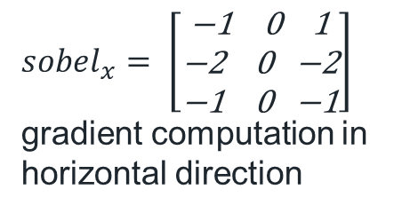
Lane detection in Lane Tracing Assist
$sobel_{y}=\left[\begin{matrix}\text{ 1 2 1} \\ \text{ 0 0 0} \\ \text{−1 −2 −1}\end{matrix}\right]$
gradient computation in vertical direction
$$Gray=$$
$$R∗0.30+G∗0.59+B∗0.11$$
$$Gaussian=$$
$$\left[\begin{matrix}\text{ 0.0947 } \text{ 0.118 0.0947} \\ \text{ 0.118 0.1}48\text{ 0.118} \\ \text{ 0.0947 0.118 0.0947}\end{matrix}\right]$$
$sobel_{x}= \left[\begin{matrix}\text{−1 0 1} \\ \text{−2 0 −2} \\ \text{−1 0 −1}\end{matrix}\right]$
gradient computation in horizontal direction

Slide 5
Bottleneck analysis in SW implementation
Processing stage | Time (ms) | Percentage
Gray processing | 64.8 | 10%
gaussianBlur | 118.3 | 20%
Sobel_x | 152.2 | 26%
Sobel_y | 152.2 | 26%
addWeighted | 18.3 | 3%
Others | 89.3 | 15%
total | 595.2 | 100%

Slide 6
SOLUTIONS?

Slide 7
Overall Design

Slide 8
Communication

Slide 9
Off-Chip On-Chip Data Transmission
AXI-Stream Interface

Slide 10
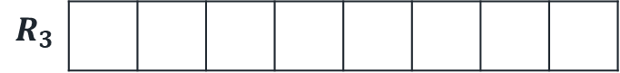
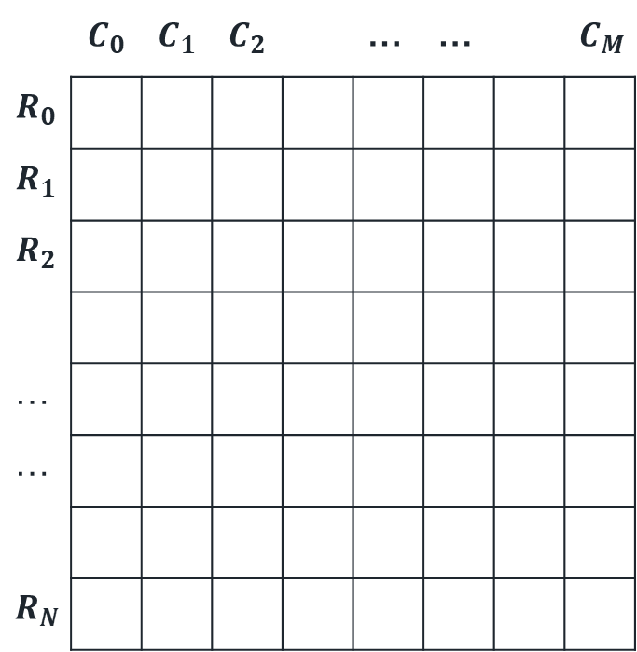
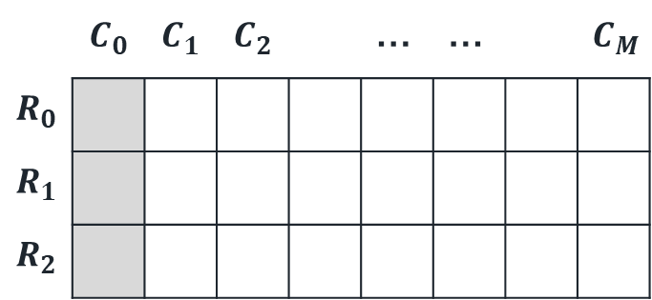
ORIGINAL IMAGE
Line buffer
Sobel kernel
 | $$C_{0}$$ | $$C_{1}$$ | $$C_{2}$$ |  | … | … |  | $$C_{M}$$
$$R_{0}$$
$$R_{1}$$
$$R_{2}$$
…
…
$$R_{N}$$
 | $$C_{0}$$ | $$C_{1}$$ | $$C_{2}$$ |  | … | … |  | $$C_{M}$$
$$R_{0}$$
$$R_{1}$$
$$R_{2}$$
$$R_{3}$$

Slide 11
Latency of Each State Machine
IP core | Negative slack | BRAM | DSP | FF | LUT | Latency | Interval | Pipeline type
RGB2gray | - | 0 | 65 | 3992 | 6711 | 262172 | 262172 | None
AddWeighted | - | 0 | 39 | 2534 | 4145 | 262167 | 262167 | None
Gaussian Filter | - | 3 | 25 | 486 | 1022 | 786951 | 786951 | None
Sobel_x | - | 3 | 1 | 416 | 821 | 786951 | 786951 | None
Sobel_y | - | 3 | 0 | 414 | 804 | 786950 | 786950 | None
Stream2Mem | - | 0 | 0 | 97 | 201 | 262152 | 262152 | None
Mem2Stream | - | 0 | 0 | 68 | 195 | 262153 | 262153 | None
gray2RGB | - | 0 | 0 | 26 | 123 | 262146 | 262146 | None
Total | - | 23 | 65 | 9555 | 15940 | 786992 | 786952 | Dataflow

Slide 12
Resource Usage
Resources | Utilization | Available | Utilization %
LUT | 9047 | 53200 | 17.01
LUTRAM | 832 | 17400 | 4.78
FF | 9795 | 106400 | 9.21
BRAM | 6.50 | 140 | 4.64
DSP | 65 | 220 | 29.55
BUFG | 1 | 32 | 3.13

Slide 13
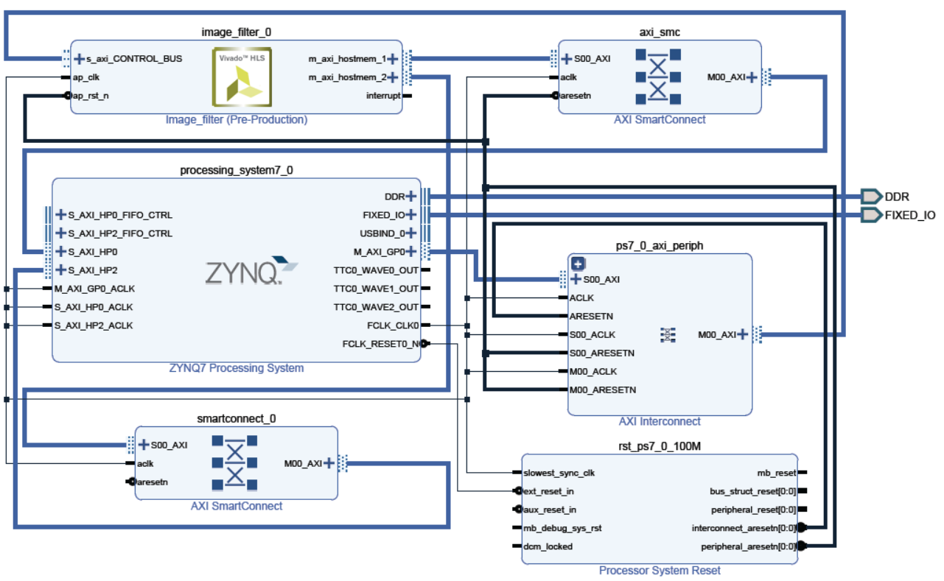

Slide 14
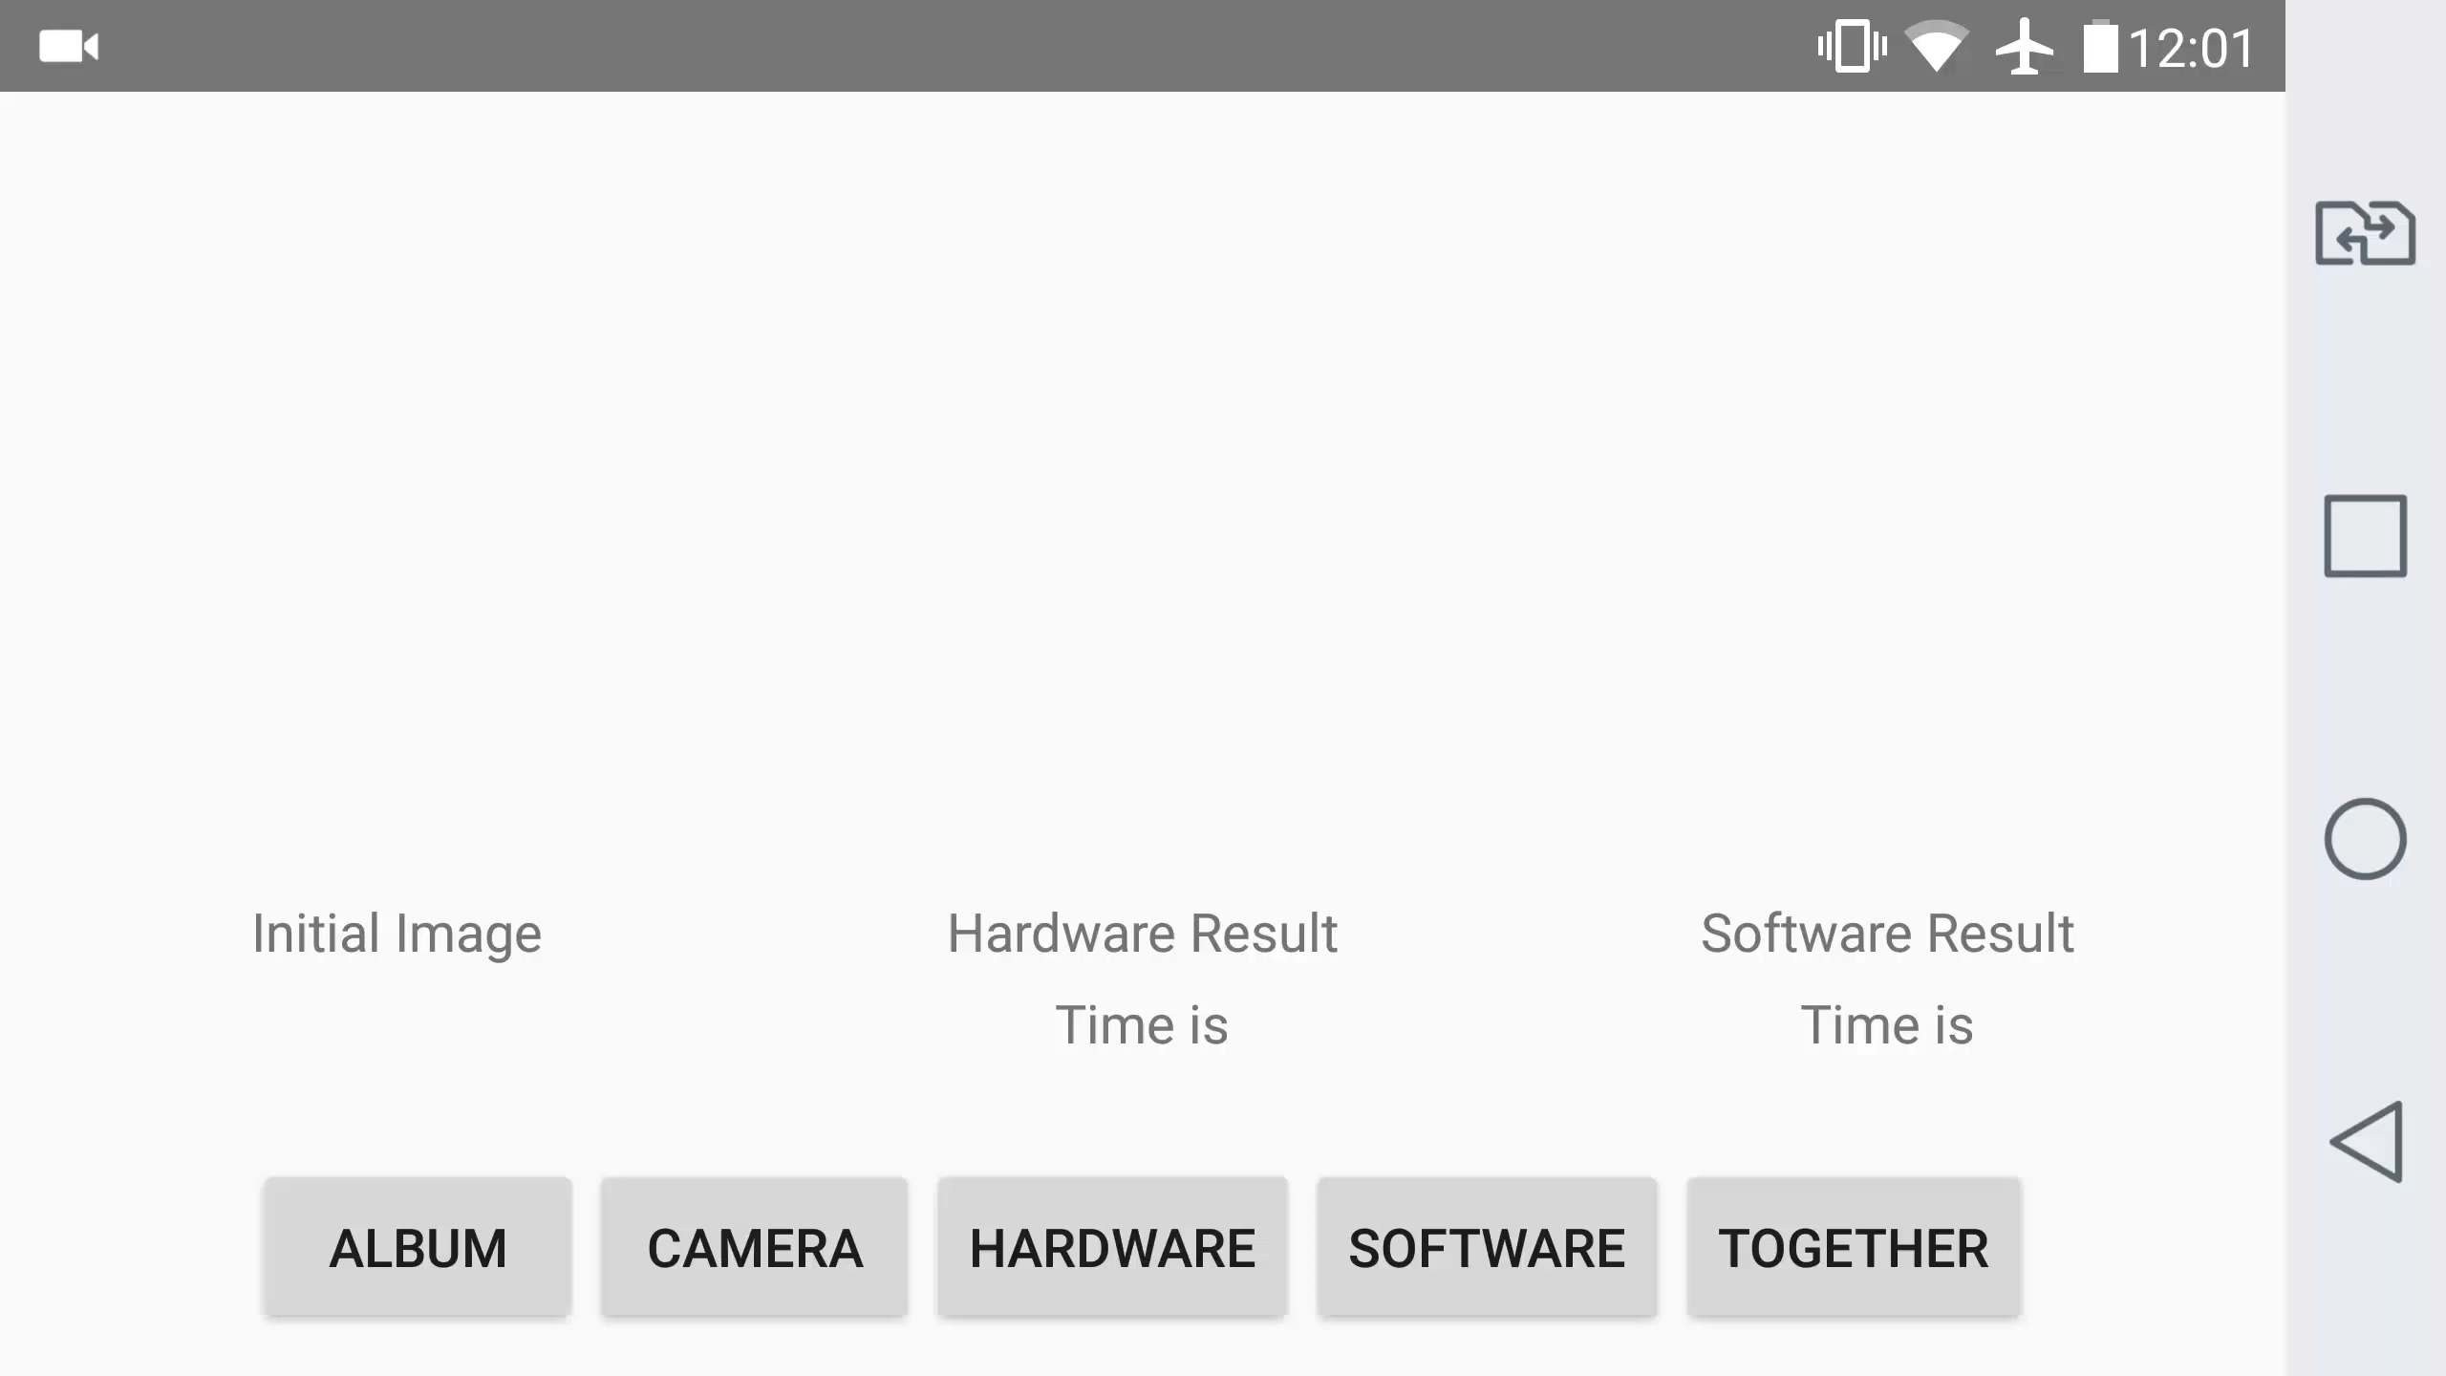

Slide 15
Receive data
Send result
Sobel filter accelerator
Compound & irregular components
Hardware
Socket server
Image decompression
Image resize
Edge detection-Sobel filter
Design level
Scalability &
Portability
challenge
software
Phone----ZedBoard
Socket interface
WiFi + Ethernet
ARM core----FPGA
AXI interface
Network
Accuracy loss

Slide 16
Thank you

Slide 17


